Slide 1
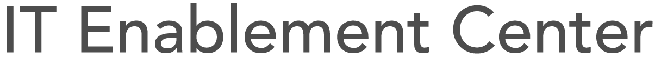
Corporate Technology Group
DevOps @ Fidelity Investments
October 2014
Sean Egan, Principal Architect
Jackie Owino, Principal, Agile Coach
Notes:
Sean

Slide 2
Our Heritage
Founded and privately held since 1946
Our goals have always been:
To democratize the world of investing by making financial expertise broadly accessible and effective
To create a courteous, respectful and challenging workplace where people can develop and grow their careers
Notes:
Sean
Fidelity Investments is a private company founded in 1946 by the Johnson Family and is now one of the largest mutual fund & financial services groups in the world.

Slide 3
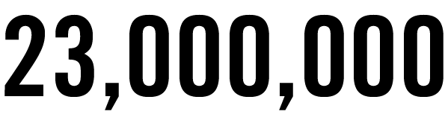
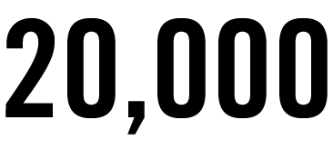
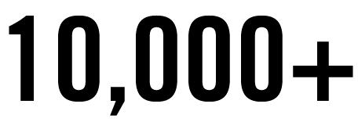
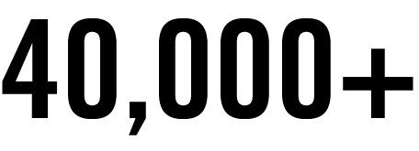
Company Overview
We serve:
People investing their life savings
Employers managing employee benefits
Financial advisory and brokerage firms serving more than 4,000,000 investors
Employees who are “proud to work at Fidelity”*
* Stated by over 90% of our employees for all three consecutive years that the survey has been conducted
Notes:
Sean
We serve over 23m investors, 20k employers and nearly 10k financial advisory & brokerage firms serving more than 4m investors.

Slide 4
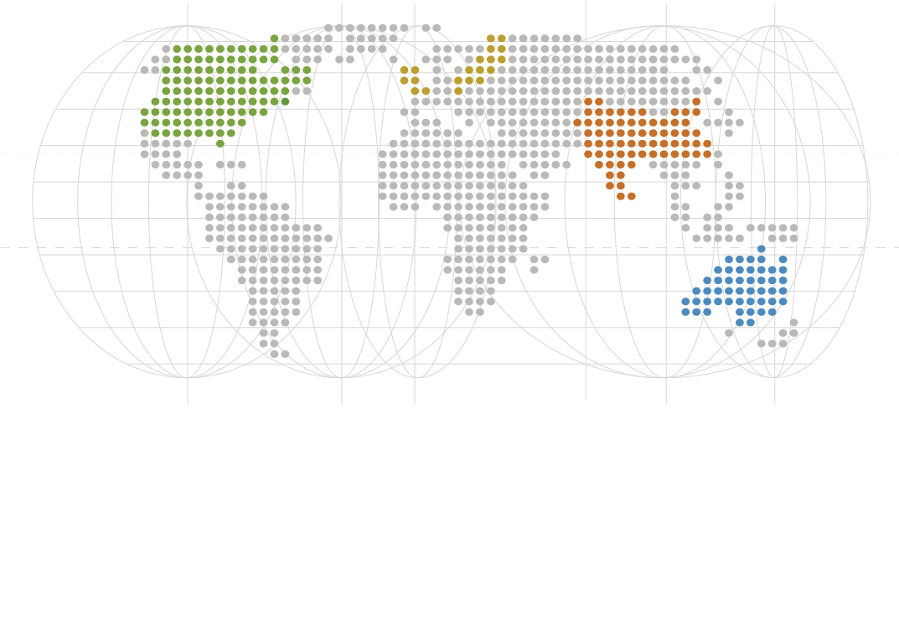

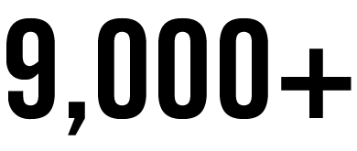
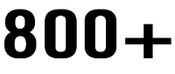
Our Reach
40,000+ associates at 10 regional sites and more than 180 Investor Centers in the U.S., and in 11 different countries
North America
Europe
Boston, MA
Asia
Australia
Customer representatives
Technology associates
Investment management professionals
Data as of 12/31/13
Notes:
Fidelity has 40,000-plus associates located at 10 regional sites and more than 180 Investor Centers in the United States, as well as in 11 other countries.
More than 9,000 of our associates work in the area of technology, building, maintaining and discovering new and better ways to serve our customers.
Most of Fidelity’s many diversified businesses are contained within our four major business lines:
Asset Management organization , Personal Investing, Workplace Investing and Institutional Services .

Slide 5


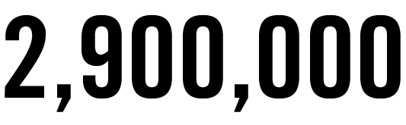
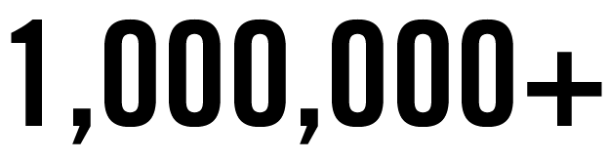
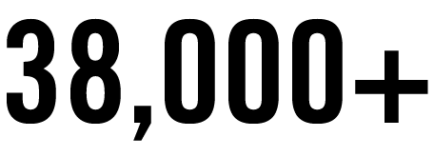
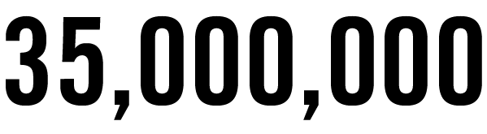
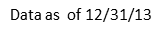
Our Technology
Technology that inspires people to see their finances in new ways.
Our goal is to use technology to give people the power to take control of their financial futures anytime, anywhere.
nearly
Visits per day to Fidelity.com
Mobile transactions in 2013
Downloads of our mobile advisor and broker platforms
Dollars deposited across our mobile check deposits technology for advisors and brokers
Notes:
We are a Technology company. Throughout our history we has always recognized the power of technology to serve our customers by providing access to investing knowledge and tools that help them successfully manage their financial lives.
Fidelity works every day to stay ahead of this technology curve, and to give people the power to take control of their financial future anytime, anywhere via our website and mobile platforms.
Investors conducted more than 1,000,000 financial transactions in 2013 on our mobile platform. An increase of 66% on 2012, and we expect even bigger increases this year.
… so where do we fit in ?

Slide 6
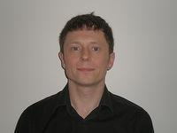
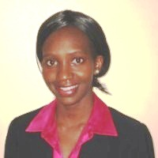
Who are we?
Sean Egan
Principal Architect
Dublin, Ireland
Jackie Owino Principal Methodology Coach
Research Triangle Park, NC
Notes:
Sean: My name is Sean Egan, as you can tell from my accent, I am not from the US, but from the west of Ireland where Fidelity has development offices. I have worked as a software engineer for the past 20 years, focusing primarily in SCM, and ALM integrations for many large organisations including telecoms, embedded systems, and financial services all over Europe & the US.
I am currently an ALM Architect for IT Enablement Center within FMR focused on building the next generation of lightweight enterprise development environments for our geographically distributed agile teams.
----
Jackie:
----
My name is Jackie Owino and I Agile Coach at Fidelity Investments based in RTP, North Carolina. As you can tell.. I am also not originally not the US but… thanks to the MD102 program I have been a citizen for several years. I graduated from over 15 years of experience working with development teams in mobile, marketing and financial industries. I have had the opportunity to coaching of both development and infrastructure teams which has driven both my passion in their adoption of agile methodologies as well DevOps practices. As part of larger team we would like to share our journey and what our current focus has been in enabling DevOps practices and its adoption at scale

Slide 7













IT Enablement Center - Enabling Business Value Holistic & integrated approach to business & technology lifecycle
Research
Collaboration
‘Bring the outside in’
‘Bring the outside in’
Enabling technological creativity
Mission:
Technology
Effectiveness
& Efficiency
Platform Delivery
Organization Coaching
Supports technology delivery methodology planning, build, test & deploy activity
Sustaining model
Technology = Results
Notes:
Jackie
Sean and I are part of an IT Enablement Center, a division within the Corporate Technology Group charged with providing technology solutions at scale.
Our mission is truly to enable Fidelity’s businesses to deliver the best customer experience and products in the Industry.
We do this by being Change Agents, Challenge the Status Quo.. Enabling people to think out of the box
We Lead by Example.. and very often have been called upon to Changing the Dialog
Promote Best Practices – From planning all the way to delivery
We also provide the Shared ALM Offerings to enable this
-------

Slide 8



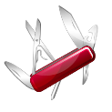


Drivers
Time to Market
Agility and Speed
Resource Flexibility
Compute, Storage and Network
Availability and Resiliency
Improvements in SLA’s
Self Service provisioning
What you want – How you want it
Drive Innovation
Promote Culture of Experimentation
Operational Support
Streamline Maintenance
Economies of Scale
Reduce IT Costs per Unit
Notes:
Jackie
Here are our key drivers … that we have aligned with our DevOps vision . Some are obvious .. And common to what we have seen in several presentations
Critical to us in the next 12 months is
..
Self service provisioning .. Providing the ability for development and Ops teams to stand up their own environment whenever they want . In conjunction with that it is key to have a compute strategy to satisfy and scale to the demands of these extra environments.
Drive innovation by providing education and coaching that promotes a culture of experimentation.
Key to us is also ..Leveraging our economies of scale …. To reduce our IT costs per unit of SW developed

Slide 9
It’s all about delivering a “Unit of Value”
Waste
Coordination Cost
(i.e., Meetings, Status, etc.)
Value adding activity
Non Value Added
Transaction Cost
(i.e., Setup, Tool Management, etc.)
Transaction Cost (i.e., Environment Provisioning, etc.)
Waste
Waste
Waste
If you could, would you do it more often?
Notes:
Sean
Here we see the results of analysis we did on the time/money spent on a typical project: Setting up the tooling, multiple meetings, testing undefined requirements, manual testing, manual deployments, etc.
As you can see there is a lot of waste. All of this gets in the way of delivering applications at a faster rate.
So, the question we asked ourselves, If you could take smaller pieces and deliver them more often, would you?

Slide 10
Reduce the cost of delivering a “Unit of Value”
Leverage Transparency Provided by the ALM Tool to provide Application and Process Insight
Deliver More Value
Coordination Cost
Transaction Cost
Automate the setup process
Transaction Cost
Failure Load
Automate the provisioning process, testing, etc.
Write Unit Tests, Write Integration and Function Tests, Leverage Automation, etc.
Notes:
Sean
So, how do we achieve this?
By remove all the manual steps in project initialization, for example; automate the creation of agile projects, repositories, build jobs, static analysis, etc.
By leveraging the appropriate Agile planning frameworks and tooling to provide application & process insight without dragging every developer into every meeting. Maybe even get rid of a few meetings?
By adopting proven developments methodologies (such as TDD) to write unit tests, integration & function tests, and automating this as much as possible.
And finally by formalizing & automating the provisioning process.
-------

Slide 11
Shared Vision: “Agile Coaches Lens”
Agile Coaching
Organizational (Guided Onboarding and Transition)
Clear Roles and Responsibilities
Sustainer Programs
Faster Delivery
Backlog Management
Release/ Roadmap Planning
Portfolio and Program planning
Better Quality
Methodology Support
Execution
Leveraging Technical Practices
LEAN Documentation
Agility
Reduce Cost
Feedback Loops
Dashboards and Reporting (Metrics)
Maturity Assessments - Agile, Kanban, Devops
Notes:
11
Jackie ( Relating To the values)
So how do we achieve this shared goal of enabling faster delivery , improved quality for a reduced cost?
I would pause and talk about our journey, some key focus areas that have emerged over the years through partnerships with teams in the different business units … what I would call an evolutionary approach to our coaching engagement model.
While ITEC has been in existence for over 5 years.. Agile frameworks and adoptions in Fidelity have been in play for much longer. Several of our coaches have been pioneers in defining and introducing lean methodologies while working with development organizations prior to joining ITEC.
As we started the journey it was perceived that there was the need to have customized agile frameworks that were was suitable in driving adoption in an org that was still largely traditional.
The customized frameworks also helped to bridge the gaps in planning and managing large programs that are prevalent in large organisations and not well addressed in Scrum/XP.
In the past year there has been an accelerated interest in adopting agile at scale that has changed our engagement model. We have elevated the conversation and largely transitioned from coaching on a team by team basis to providing a guidance and coaching around transitioning whole organization.
We are transitioning form internal customized versions of frameworks to industry standards. This has made it easier to onboard new associates into teams as well as allowing us to speak the same language as the rest of the industry.
Their has been a focus on defining clear roles and responsibilities…..not only around agile frameworks .. But also as an example role of a functional manager.. Roles of an executive and their part in supporting that adoption .. What the common language and artifacts they should expect .. In line with industry definitions.
We are working with several BUs to establish Sustainer programs that mentor individuals it be agile champions and carry the torch forward sustaining and maturing their organization.
Backlog Management - the Apex and Central point of the Framework
-- Provided training and guidance for team to build knowledge in the areas you needed to improve on
Story writing
Strategic planning and capability modelling
Refocus… Enabling better Roadmap and release planning (fusion) ensures that the Sponsors vision is aligning with the work conducted.
leveraging some of the emerging frameworks that address program and portfolio levels and Partnering with some more mature organization to implement
Execution – This ties in closely with the key enablers of a successful devops environment
As coaches we are providing Coaching and information that is key in driving automation, measurement and collaboration around shared goals
Just like a scrum team we have built up a team of coaches with different expertise. Including the proficiency and technical knowledge around configuring the tools to support the practices (value stream mapping)
Feedback Loops
--Providing metrics that assist Teams and Management to evaluate the current state and ensure that their objectives are being met.(Execution & process)
--Continuous assessments programs.. Developed maturity assessments to help teams evaluate where they are at and guidance on what to do to reach the next level.
Recap:
Supporting documentation and coaching to support the frame works and adoption
Compass to gauge and support a kaizen culture : Metrics and continuous assessments.

Slide 12
Shared Vision: “ALM Provider Lens”
Scalability (Vertical & Horizontal)
Multi-Tenancy (Delegation of Appropriate Admin Privileges)
Faster Delivery
Better Quality
Openness (Integrations, Extensibility, Web Services-REST)
ALM Support
Agility
High Availability (Support multiple BUs across the world)
Reduce Cost
Reporting Capability (Meaningful metrics to make better decisions)
Notes:
12
Sean
So as an ALM solution provider, how do we achieve this shared goal of enabling faster delivery , improved quality for a reduced cost?
Before we get there, it’s important to understand where we’re coming from. Fidelity has probably got at least one instance of nearly every ALM tool ever sold somewhere in the organisation.
Sometimes multiple, each with a completely different implementation/support model. This is not sustainable, teams are spending time maintaining non-core applications, in sub-optimal ways, and it’s costing more than it should. So the IT Enablement Center was created.
As you heard yesterday with Netfilix, if more than one BU is looking at a particular solution, ITEC will look to take on.
There are a number of key elements for us to take into account when deciding on the ALM Solution stack to achieve our DevOps goals:
Scalability
A centralised offering needs to be able to scale to the needs of the whole organisation.
It needs to possible to grow horizontally (by adding more servers) and we need the ability to move projects, etc. between those servers.
Some of our early forays into Agile tooling didn’t go so well, they were expensive and didn’t scale to meet our demands
Multi-Tenancy
A requirement of providing a centralised ALM offering is the ability to have multiple tenants (or BUs our case) live in the same system.
The solutions need to provide robust Access Appropriate to Role for Security, which can be integrated with LDAP for Authentication and Authorisation.
We cannot (nor do we want to) provide all of the support for each BU.
We want to leverage a two-tier support model, where we look after the application infrastructure (i.e. server, DB, HA, DR, etc.) and the BUs manage their projects within
Some of our older SCM solutions are not able to support this model. Most notably the concept of roles and LDAP integration. Some were also too restrictive to enable proper CI-CD adoption.
Openness
No single vendor appears to be able to provide a single solution right across the ALM stack, so it’s our policy to leverage the best-in-breed applications and integrate them together.
Therefore extensibility and REST based services are imperative to our solution.
High Availability
The more we automate the provisioning, testing, delivery (and finally deployment) the more critical our solutions become.
Being centralised also means much less opportunity to have downtime for patching, etc.
We provide all of our applications with datacentre DR, and aim to achieve active/active clustering falling back to active/standby for HA
Reporting Capability
The ability to generate meaningful metrics is key for making better decisions. Each solution has to have audit trail for our audit & compliance requirements.
It must also have the ability to extract the data (preferably via REST) to be loaded into our data-warehouse for further analysis & reporting
We also need solutions to support our target platforms (which is mainframe, Enterprise Java and .NET). Given our best-in-breed preference, these span across multiple vendors, for example Rational, Atlassian, Microsoft, HP and Open Source.
-------

Slide 13
Continuous Delivery – CI-CD
Code Done
Dev
Test
Pre-Prod
Prod
Continuous Delivery
Auto
Auto
Auto
Manual
Code Done
Dev
Test
Pre-Prod
Prod
Continuous Deployment
Auto
Auto
Auto
Auto
Continuous Delivery is about putting the release schedule in the hands of the business, not in the hands of IT
Notes:
Sean
As you heard yesterday, like most organisations, our focus in Continuous Delivery not Deployment.
This is where we’ll see our best “unit of value” for the organisation.
-------

Slide 14
Pilots
Underway with key Business Units
Focused on Continuous Delivery
Notes:
Jackie
So, where are we. We’ve pretty mature in our agile adoption, most teams have got CI in place, and if not, they’re in the process of doing it.
We have partnered with some key BUs to understand the landscapes within which their working and to build a cohesive plan focused on continuous delivery.
-------

Slide 15
DevOps Metrics
How well are you doing?
Where can you Improve?
Throughput Metrics
Deployment Frequency
Lead Time for Changes
Stability Metrics
Mean Time to Recover
Change Fail Rate
Building
Talent & Culture
Testing
Deploying
Reporting
Notes:
Jackie
How do we know how effective we are in adopting Continuous Integration (CI) and Continuous Delivery (CD).
Just like you heard already, the key is providing objective data to assess the effectiveness of our effort, from different perspectives.
An extra facet to these metrics is a specific focus on Talent & Culture, that we have added is our DevOps Maturity assessment. Traditionally this has been overlooked as it’s not easy to measure.
~ Development and Operations meet to create a common schedule and understanding of requirements
~ Joint Planning sessions , demos, retrospectives that include both development and Ops
~ More advanced .. Incorporating DevOps thinking into our Career planning and building

Slide 16
Build & Deployment Metrics
May
June
July
August
Notes:
Jackie
We currently measure and report on the number builds & deployments metrics for each application and aggregate it up to BU.
In addition we measure success rates and trends for these different applications.
We’ve seen CI build increase by 50% and Deployments by 100% this year.
-------

Slide 17
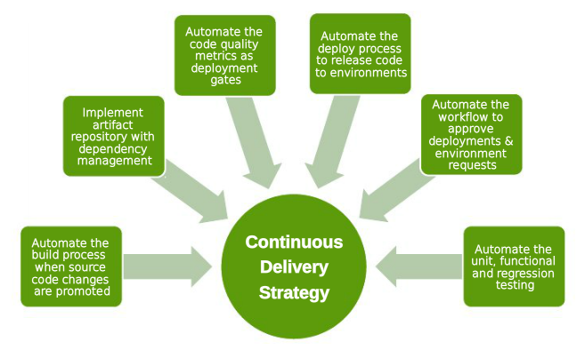
Speed @ Trust
Notes:
Jackie
To reiterate, our focus is partnerships with our BUs and our mantra is Speed @ Trust, applying it to every component of our continuous delivery strategy.
-------

Slide 18
What have we learned?
Establish a combined vision
Focus on education
Select the appropriate tools for the job
Measure
Kaizen
Notes:
Sean
So, what have we learned so far on our journey to DevOps?
It’s imperative to have shared vision, with clear goals and executive buy-in.
You need to implement the appropriate tools for the job.
Measure, Measure, Measure, and use those metrics for continuous improvement.
-------

Slide 19
Where can you help us?
Test Automation of Legacy Code
Enabling a blameless culture
Metrics
Notes:
Sean
So, what do we need help with?
We like every other large organisation here, have a large legacy code base which we need to test
How can we encourage this blameless culture
What other metrics could & should we be providing?
-------

Slide 20


Slide 21

Questions

